Slide 1


J. Kellogg Parsons, David Zarieh, John P. Pierce, James Mohler, Electra Paskett, Donna Hansel, Adam Kibel, Olwen Hahn, John Taylor, Lannis Hall, Sean Stroup, Eric Small, Peter Van Veldhuizen, Michael J. Morris, and James Marshall
The Men’s Eating and Living (MEAL) Study (CALGB 70807 [Alliance]): A Randomized Clinical Trial of a Diet Intervention in Men on Active Surveillance for Prostate Cancer
Support: UG1CA189823, U10CA037447, U10CA011789, U10CA041287, U10CA059518, U10CA077651, U10CA077658, U10CA138561, U10CA180791, U10CA180850, U10CA180866, U10CA180888, National Cancer Institute 1R01 CA132951-01A1, Department of Defense PC073412, and The Prostate Cancer Foundation.
ClinicalTrials.gov Identifier: NCT01238172

Slide 2



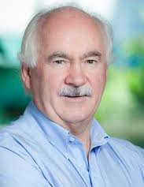





Slide 3
Objective:
To determine if altering diet will reduce progression in active surveillance for prostate cancer.

Slide 4
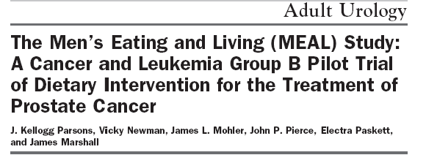
MEAL is Translational Medicine
Population
Studies
Phase III
Phase II
Laboratory
Studies
Pre-surgery
Studies

Slide 5
Counseling Call Center
UC San Diego
Patient
Patient
Patient
Patient
Patient
Patient
MEAL is:
Cheap.
Efficient.
Scalable to large populations.
Removes economic and practical burdens from patients.
MEAL is not:
Complementary medicine.
Wellness.
Goal: ≥ 7 servings/ day of vegetables.
Emphasis on raw carotenoids (tomatoes and carrots).
MEAL is:
Scientifically-designed, validated behavior change.
Grounded in social psychology
Promotes self-efficacy: capacity to execute behaviors to produce specific performance attainments*
*American Psychological Association

Slide 6
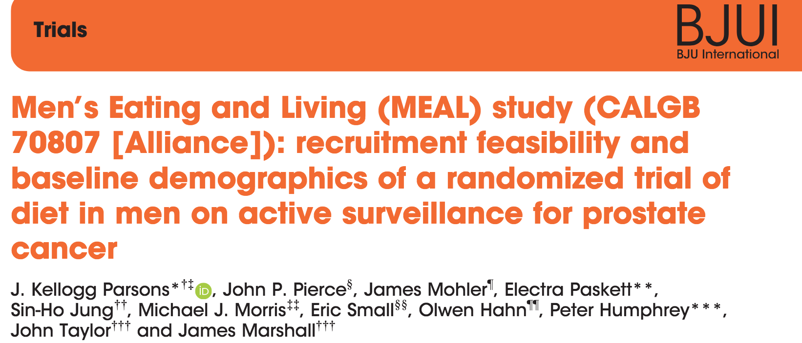
BJU Int 2018; 121: 534-539

Slide 7
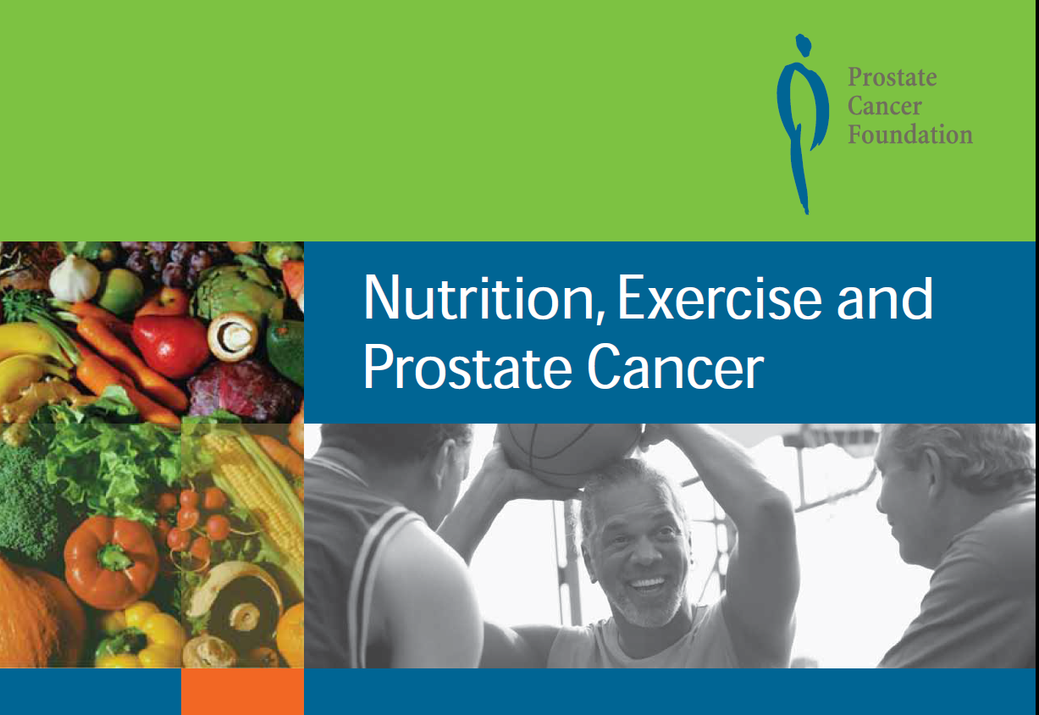
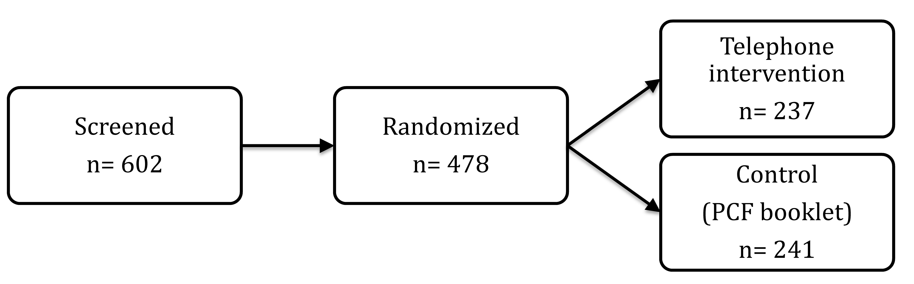
2011 to 2015

Slide 8
Primary endpoint: clinical progression
PSA > 10 ng/mL
or
PSADT < 3 years
or
Pathologic progression

Slide 9
Secondary endpoints
Incidence of active treatment
Adherence to diet
  24-hour diet recall (telephone interview)
  Plasma carotenoids

Slide 10
DIET ADHERENCE

Slide 11
Total Vegetables
Servings/Day
p < 0.001

Slide 12
Lycopene
(Intake/day)
p < 0.001

Slide 13
Fat Calories
(kcal/day)
p = 0.02

Slide 14
Plasma Carotenoids
p < 0.01
p = 0.08

Slide 15
PRIMARY OUTCOMES

Slide 16
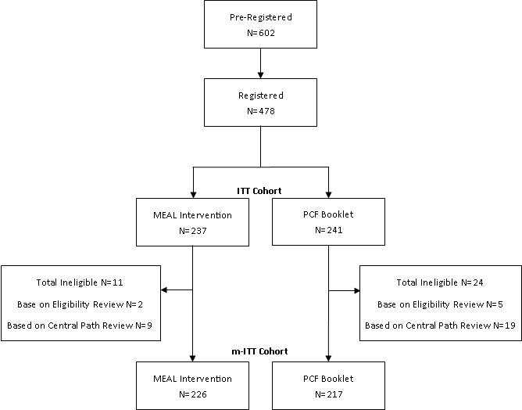
n = 443
91 sites
Groups comparable
12% African American
< 2% Gleason 3+4=7

Slide 17
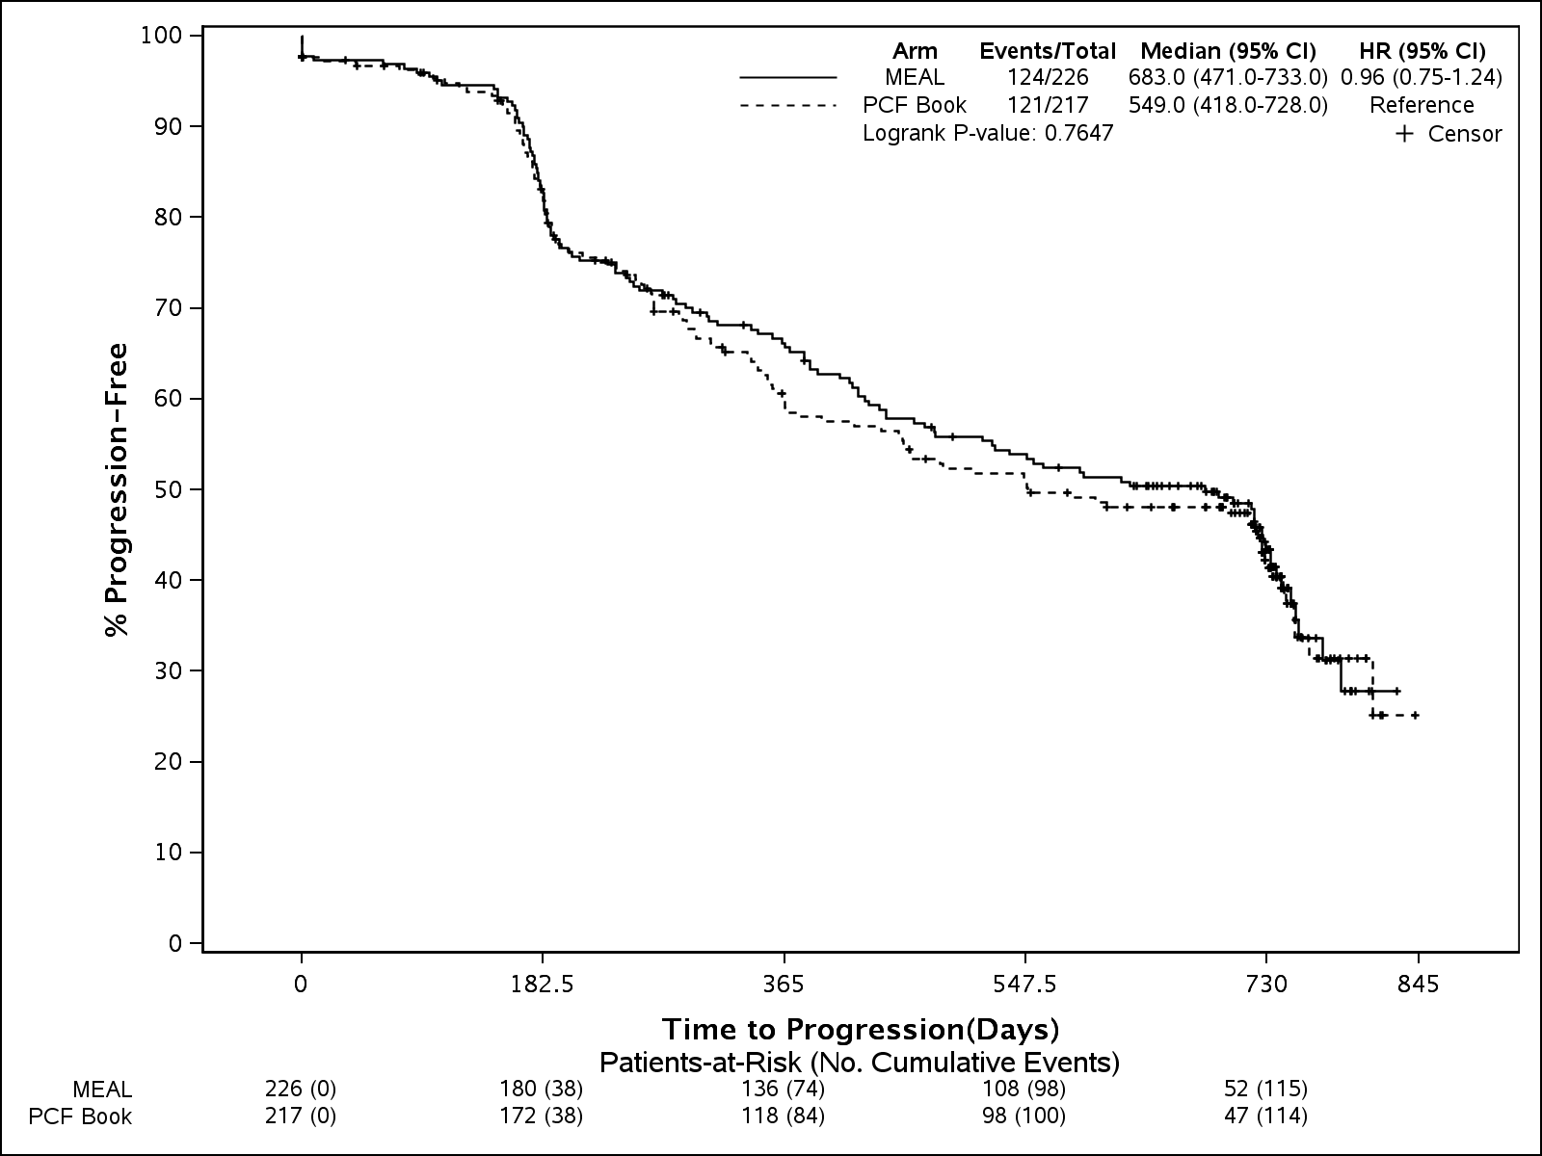
Primary Endpoint:
Time to Progression
HR 0.96
(95% CI: 0.75, 1.24) p = 0.76

Slide 18
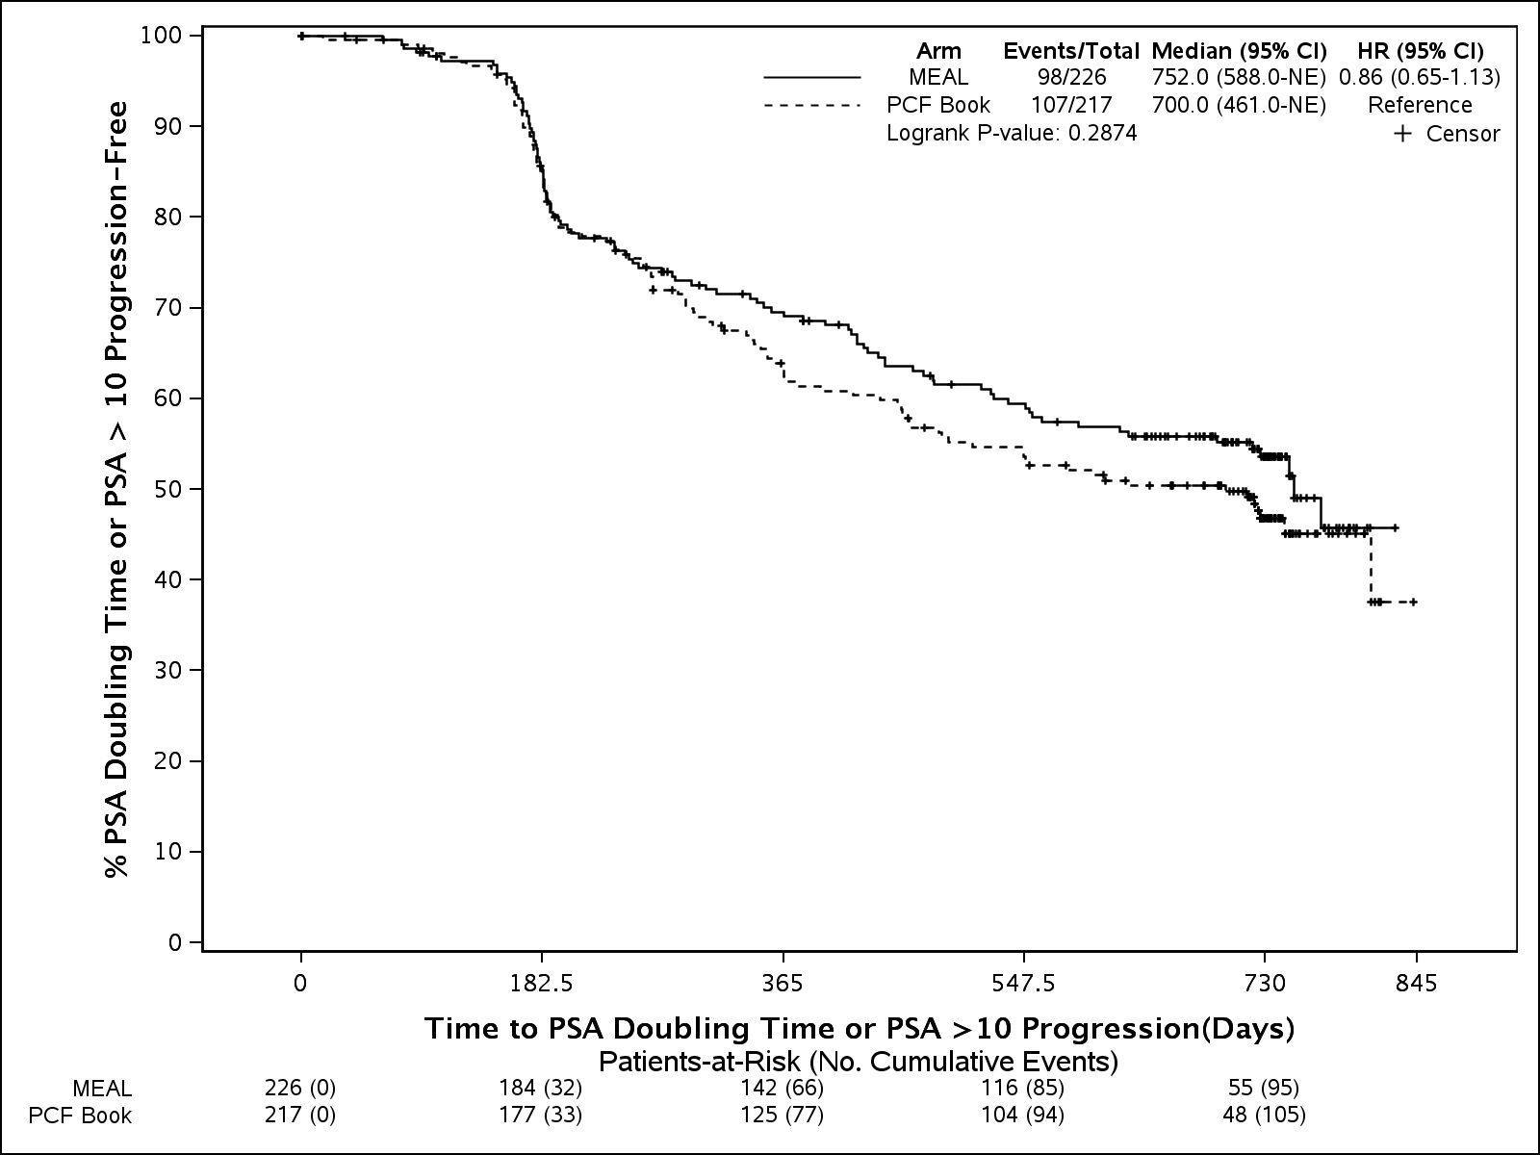
PSA-specific end points: PSA > 10 ng/mL or doubling time < 3 years
HR 0.86
(95% CI: 0.65, 1.13) p = 0.29

Slide 19
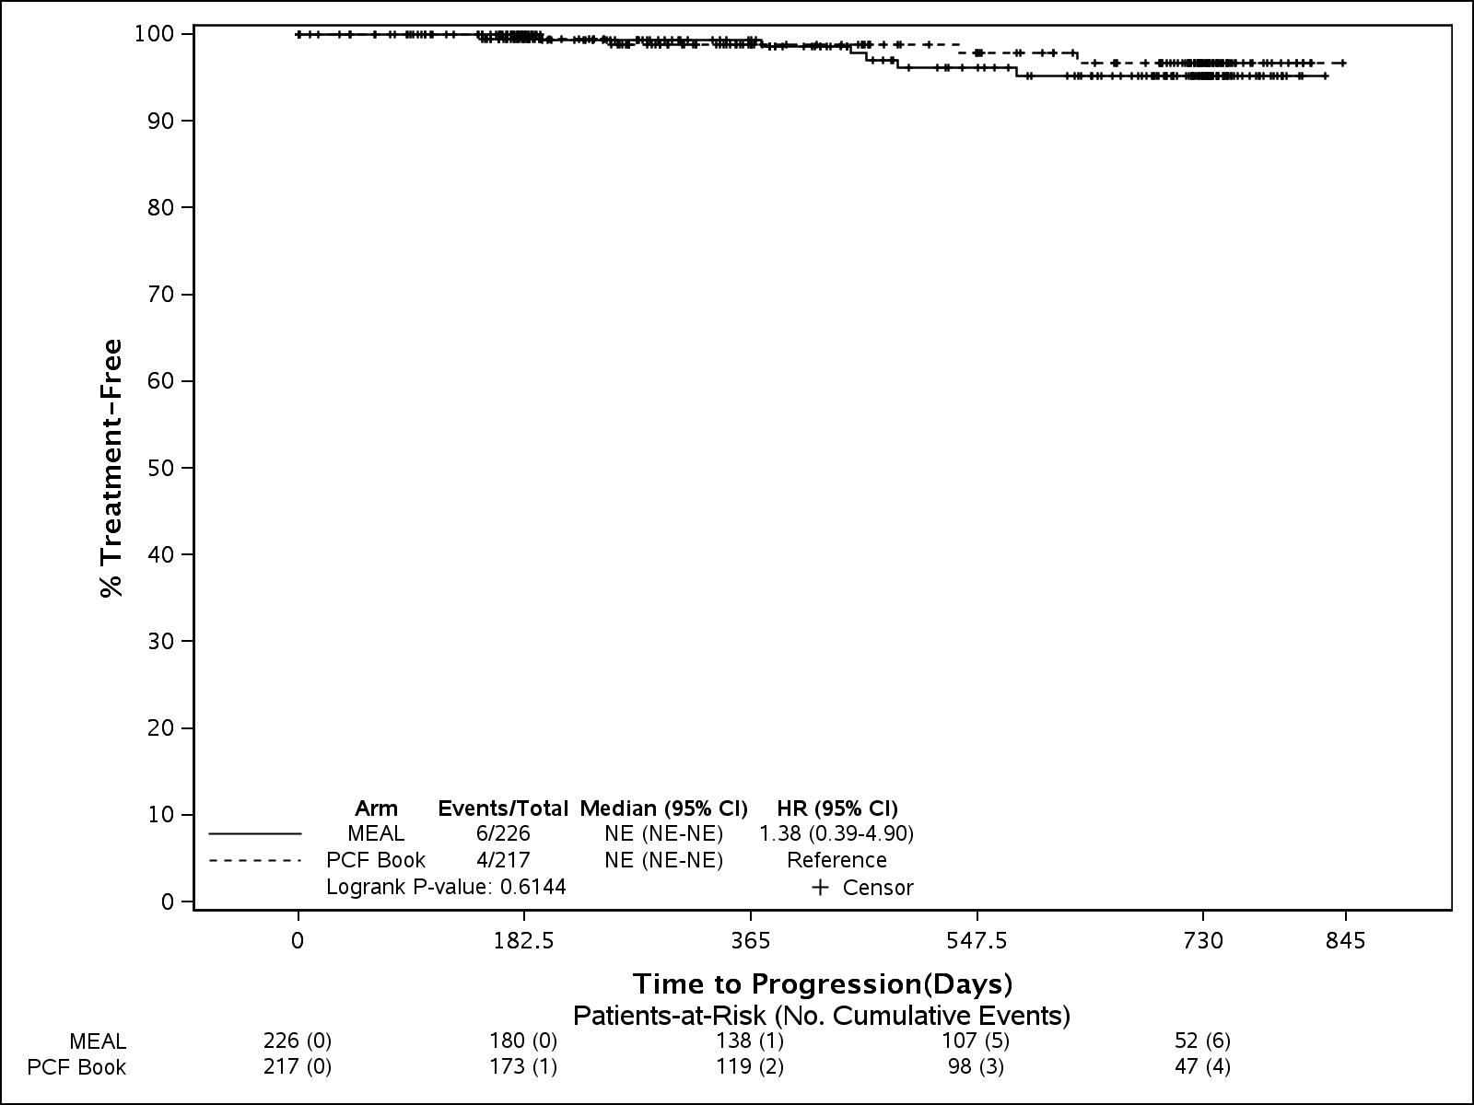
Time to Treatment (Surgery or Radiation)
Treatment rates
2.7% (MEAL) vs 1.8% (Control)
p = 0.61

Slide 20
Conclusions
1st successful, sustainable behavior intervention in prostate cancer.
No significant effect on 2-year clinical progression in active surveillance.

Slide 21
Take Home Messages
Large-scale diet change in prostate cancer is feasible.
No significant effect on shorter term clinical progression.
Longer term effects unclear.

Slide 22
An Unfolding Story:
Upcoming MEAL Data
Quality of Life
  FACT-P, EPIC, MAX-PC, I-PSS
Genetic predictors of response to diet
  Precision medicine: one size ≠ all
Biomarkers in active surveillance
  Blood and tissue

Slide 23


Questions?
@drkellyparsons

